Slide 1
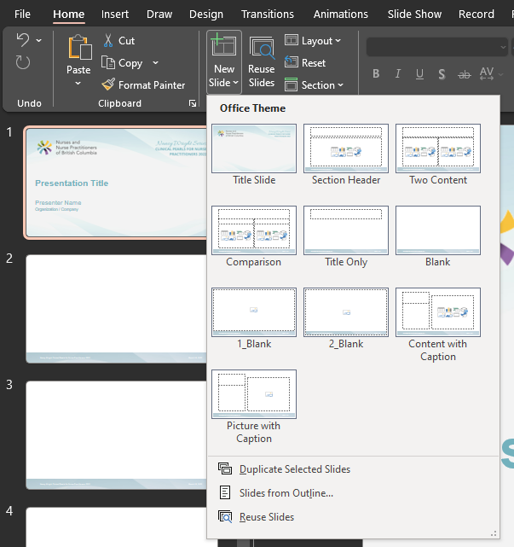
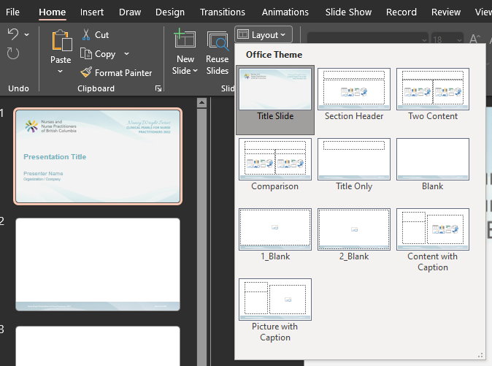
This template offers various slide layouts that you can choose from.
Insert new slide
Apply layout to existing slide

Slide 2
Presentation Title
Presenter Name
Organization / Company

